Slide 1

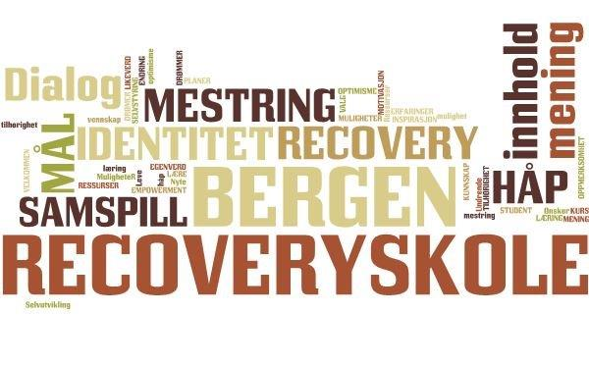

Notes:
Audun – takke for invitasjonen

Slide 2

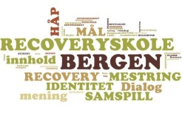

Who are we?
Susanne Albertine Davidsen
    Expert by experience and professional
  Bergen Recovery College
Anne Turid Nygaard
  Adviser For the Recovery College and
  Agency of Mental Health and substance abuse
Notes:
Både Anne Turid og Susanne– hver presenterer seg

Slide 3
What we will talk about
The inspiration and the beginning
Purpose and core principles
Course Examples
Quality criteria from Nottingham Recovery College
Bergen RecoveryCollege – The peer teachers
  Student evaluations
  Preparing before courses
  Building an environment
  Teachers reports
  Preparing teachers
  What is important to our peer teachers?
Notes:
Anne Turid

Slide 4
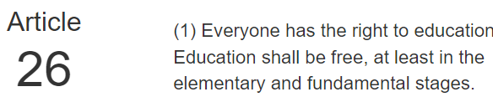

The inspiration
September 2017 : Conference -Refocus on recovery – Nottingham
Visits to and from Nottingham recovery college
Workshop in Copenhagen with 5 recovery colleges in Denmark

Slide 5

From plan to action
Open invitation to service users and professionals in March 2018
  Goal: Getting topics for making the first courses at the College.
2. Co –production
3. Framework:
  There were established a steering group
  a ratification board for approving the courses
  and a recourse group for volunteers.
4. Key persons from Nottingham Recovery College to Bergen to help us setting the framework (5 days) and quality criteria
Notes:
1. After a democratic process with votes, we ended up with 3 topics
2. People could sign up for the groups with the topic they wanted to join
Each group had a process manager

Slide 6
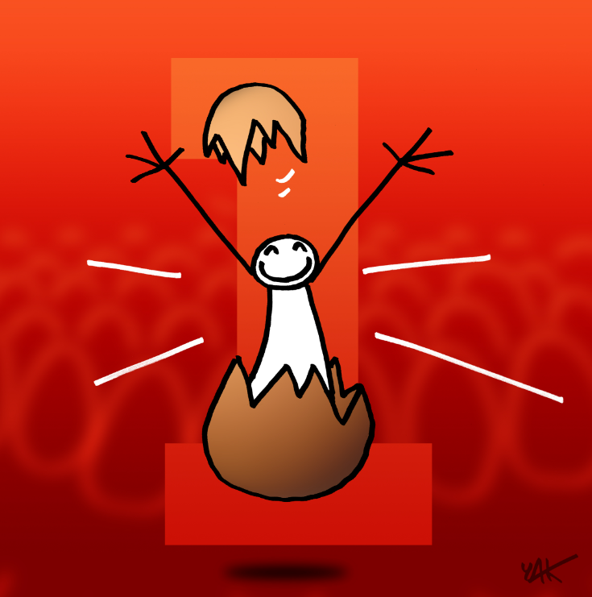
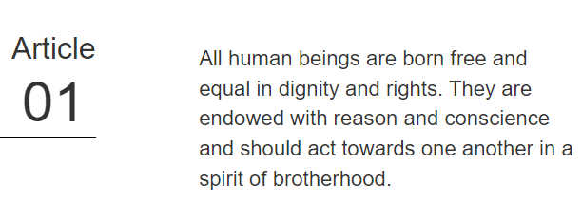
Purpose
The main purpose of the school is to convey knowledge and inspiration that can contribute to the students choosing to work with their own recovery
Notes:
Anne Turid

Slide 7
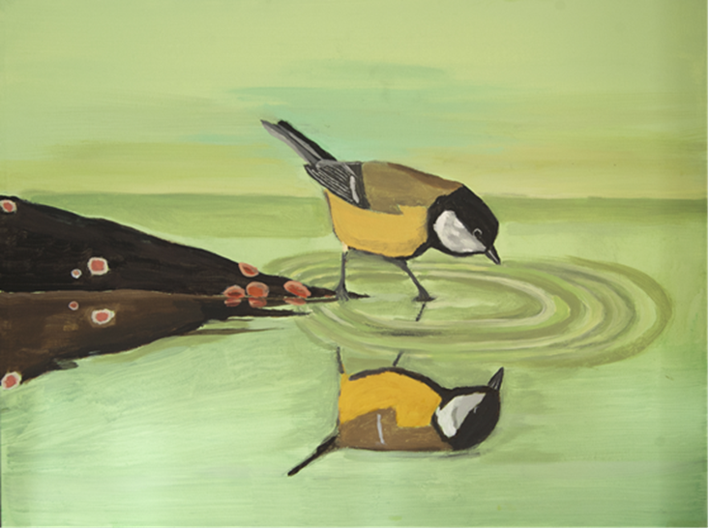
Recovery for us is a way of thinking that creates opportunities
Bergen RecoveryCollege shall promote:
  Belonging and participation
  Hope and believe in opportunities
  A positive identity – outside the illness
  Meaning in life
  Managing ones own life
Sissel Eide. Hvem er du?
«who are you?»
Notes:
Anne Turid

Slide 8
Core principles
Educational
Colaborative – co-production in all processes
Person centered and focus on possibilities and resources
Progressive and supporting – «we believe you can»
Community facing
Inclusive – welcoming students of all types
Notes:
Anne Turid
Based on educational pronciples – and all learning are based on their wishes and aspirations.
..
‘Community – Active engagement with community oranisations and mainstreem education

Slide 9
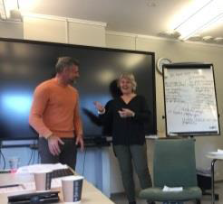
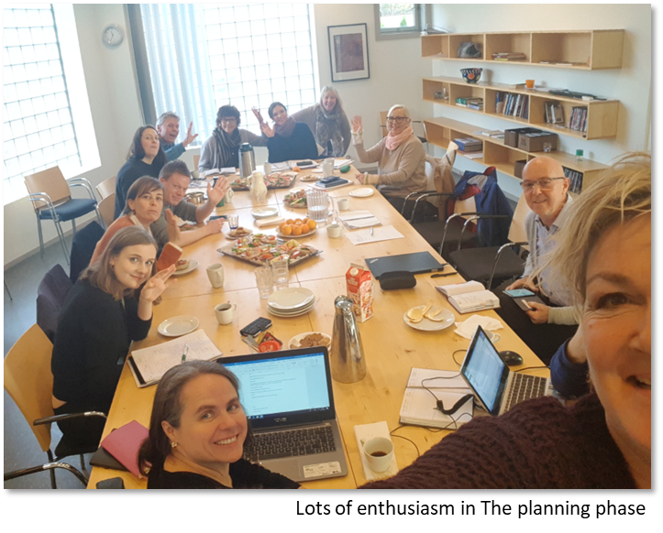
Co-production is for us:
Co - planning
Co - teaching
Co - learning
Co - evaluation
Co - management
Notes:
Anne Turid
Peers and professionals working together all the way -

Slide 10

Training the trainers
Special training of the trainers/teachers is obligatory - even if they are educated teachers/professors
Notes:
Anne Turid PEDAGODJI

Slide 11
Courses
Understand yourself (a little) better and do something about it
  4 weeks, 3h per week
Introduction to Mindfulness
  4 weeks, 3 h per week
Diet and physical activity - it's all about you!
  7 weeks, 3 h per week
Train the trainer; Health pedagogy for Bergen Recovery College
  3 days, 6 hours per day + training and support
Recovery and recovery support
  4 h x 2 weeks
From Isolation to Inspiration
  1 day
  Moore courses will come ….
Notes:
Anne Turid
Normally we will give teach each 3 hours course once a week Te longes is as you can see, 7 weeks.

Slide 12

Course Ratification
The ratification board at Bergen RecoveryCollege will ratify the courses on the following criteria:
Educational
Recoveryfocused
Evidence of Co-production
Based on criteria from Nottingham Recovery College
Notes:
I will end my part of the presentation with a short presentaston of our quality criterias

Slide 13
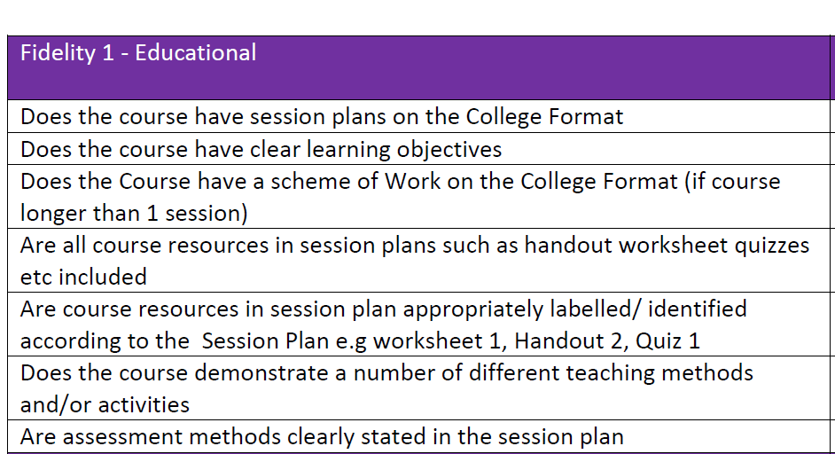
Notes:
Anne Turid
The fidelity crieria are devides in 3 categories

Slide 14
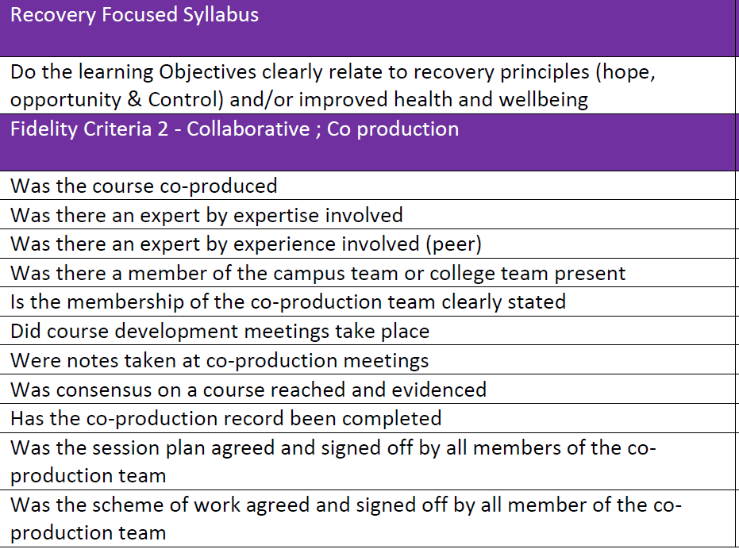

Notes:
Anne Turid

Slide 15

Bergen Recovery College
- New Chapter
Sept/oct 2022 - Training the trainers-course
Newly trained teachers engaged at the recovery college right away
8 new teachers, both peer -/professional teachers
Notes:
After down-time during the pandemic - Restart june 2022
I came into the recovery college last year, after rc had laid dormant through covid-19, and so my job was to restart the rc again.
Seemed wise to make a slow start, but the few courses held before covid had been so popular, that the rumour went ahead of us as it became clear that we were starting up our rc again – and so we needed to quickly follow up:
Startet up by recruiting new teachers, both peers and professionals from different parts of the health services and other comitted circles, arranged training the trainers course.
Aas we were eager to start up, we actually planned our first semester, based on the material of previous made courses, without yet having teachers associated to the rc – but with the intention of recruit teachers for the courses directly from the klk.
The idea: Techers would get to use (ta i bruk ) both their new involvement to the rc, and their new knowleadge of pedagogical approaches right away, without having our new teachers loose interest while waiting for us to settle in.
Tall fra klk – fag 3 + erfaring 5 = 8 wanted to take on the challenge of becoming active teachers at our college.

Slide 16

Interactive learning
  Choice of words for this occation:
  Teachers – not lecturers
Notes:
After down-time during the pandemic - Restart june 2022
I came into the recovery college last year, after rc had laid dormant through covid-19, and so my job was to restart the rc again.
Seemed wise to make a slow start, but the few courses held before covid had been so popular, that the rumour went ahead of us as it became clear that we were starting up our rc again – and so we needed to quickly follow up:
Startet up by recruiting new teachers, both peers and professionals from different parts of the health services and other comitted circles, arranged training the trainers course.
Aas we were eager to start up, we actually planned our first semester, based on the material of previous made courses, without yet having teachers associated to the rc – but with the intention of recruit teachers for the courses directly from the klk.
The idea: Techers would get to use (ta i bruk ) both their new involvement to the rc, and their new knowleadge of pedagogical approaches right away, without having our new teachers loose interest while waiting for us to settle in.
Tall fra klk – fag 3 + erfaring 5 = 8 wanted to take on the challenge of becoming active teachers at our college.

Slide 17

Experiences from students
Students evaluations:
  Increased competence
  Gained new tools
  Increased knowledge of recovery and recovery support
Peers and professionals learning together as equals –
building bridges
Notes:
Evaluations:
Students reported that the courses had provided
increased competence,
new tools for a better understanding of one's own recovery process, and also
provided security and knowledge of how to provide good recovery support to others with increased focus on the individual's own thoughts about
own needs.
Conversations with students:
Some tells us that courses at BRS have been the direct cause of their experience of a recovery process, which has lead to them seizeing new opportunities in life, feeling more in control of *********************
Some have told us that our courses has given new tools on understanding others struggling, giving them tools to better support them in their recovery process
Learning together – we say: applying as peers and professionals, but the minute you walk through our doors, we are all students. BUT
In reality, we are not only students together, - we become humans together.
By creating a Safe environment for uncovering life experiences – it becomes safe, also for the professionals, to uncover their own life experiences – we walk out of the class as equals

Slide 18

How do we prepare?
1 day joint practise per course day
  Get to know the material
  Get to know each other as co-teachers – build security
  Get to know in advance the personal experiences being used in the course
  Get to know other teachers teaching the
  same course – preparing substitutes
Always available
Notes:
Based on experience from the project period we arranged sole "days of practising" - 1 day practise per day of course, for everyone who wanted - right now or later - to give that spesific course.
Purpose: letting everyone getting to know the material together, as so to give the teachers the opportunity to also get to know the approach of the teacher they was going to give the course with. This has shown particularily useful with the fag getting to know in advance how the peer wanted to angle the peers approach.
Also: opportunity to also get to know each other as teachers across the courses, and the peers approach across the courses, which created natural vikarer in case of sudden illness, or just life getting in the way.
+ veiledningsgrupper, purpose of samle kurslærermiljø
+ Always available for questions/needs ahead of courses
Mentoring sessions – having assosciated with pedagogical Cutting-edge expertise, helping us improve pedagogical tecniques, and also quality assure our courses so they hold the best possible quality
Mentoring sessions – also serve the purpose of building a good, stable, lecturers environment at the rc

Slide 19

Building an environment
Mentoring sessions
  Process mentoring
  Pedagogical mentoring
Different kinds of teambuilding/
having fun together
Notes:
Based on experience from the project period we arranged sole "days of practising" - 1 day practise per day of course, for everyone who wanted - right now or later - to give that spesific course.
Purpose: letting everyone getting to know the material together, as so to give the teachers the opportunity to also get to know the approach of the teacher they was going to give the course with. This has shown particularily useful with the fag getting to know in advance how the peer wanted to angle the peers approach.
Also: opportunity to also get to know each other as teachers across the courses, and the peers approach across the courses, which created natural vikarer in case of sudden illness, or just life getting in the way.
+ veiledningsgrupper, purpose of samle kurslærermiljø
+ Always available for questions/needs ahead of courses
Mentoring sessions – having assosciated with pedagogical Cutting-edge expertise, helping us improve pedagogical tecniques, and also quality assure our courses so they hold the best possible quality
Mentoring sessions – also serve the purpose of building a good, stable, lecturers environment at the rc

Slide 20

Teachers reports
Both peer- and professional teachers –
personal growth
Reports feeling taken good care of
… but wish for stable locations
Feeling equal
Notes:
Both have reported feeling of good care, but expressed wish for stable locations. Takes up valuable preparing time having to arrange/prepare new/borrowed classrooms
Feeling equal – BUT equality does not mean that the professional and the peer teachers needs the same

Slide 21

How do we prepare our peer teachers?
  Guidance on expressing learning points from own personal story
  Extra support in the empowerment process, eg.​
    Speaking in public ​
    Growing in the role of being a teacher in the classroom​
    Feeling valued, as teachers, and as an essential​
    part of the making of a recovery college​
Notes:
Always available for questions/needs ahead of courses
Aside this as tiltak to prepare the course teachers, I myself have made an effort to always be available to help our teachers prepare.
Especially the peers have expressed the need for this, as the peers will have their own, often very personal take on the material. What extra help is needed :
Often more time to prepare – importance of support, presence
Some peers have needed guidance on how to express the learning points of their own story without getting too personal - to form their experience into generalised knowledge
Some peers have needed some extra support in their work/effort to become teachers (many have never spoken in public and are suddenly expected to talk to a lot of people at once)
Some peers are also just not used to have their experience being treated as of the same value as the "fag" lecturers - this can take some aquintance, and some support was needed just for the peers to manage to feel valued - both as teachers and also as a deeple needed part of the making of a recovery school.
It took some work - but I myself really felt the pride (med-stolthet) the day I myself heard at at meeting at another network somebody presented themselves as: <name>, I work at …. … AND "I am also a peer lecturer at Bergen Recovery College" (said with such pride..!)

Slide 22

What is important to our peer teachers?
  Good evaluations from students
  Opportunity to shed light on important topics
  Honest feedback
  Genuine commitment
  Peer experience within the
  management of RC
Notes:
Good evaluations from students
Gives experience of mastery
Opportunity to shed light on important topics
Such as recovery, isolation, empowerment and hope. Hope for a mental health care with diversity, means and human rights like others.
Need honest feedback from me as their guide to grow
Genuine commitment from the management
of the RC – rubs off to teachers
Peer experience within the management of RC
Have worked with personal experience and can more easily familiarize you with and guide us in challenges we face as an experiential teacher.
helps the relationship and builds confidence for the role.
example of how far it is possible to reach despite challenges
Diversity is being invited to the party; Inclusion is being asked to dance.
Equality – everybody gets to join in on arranging the dance
The use of peer support staff and their knowledge are core components of recovery-oriented services and programmes

Slide 23
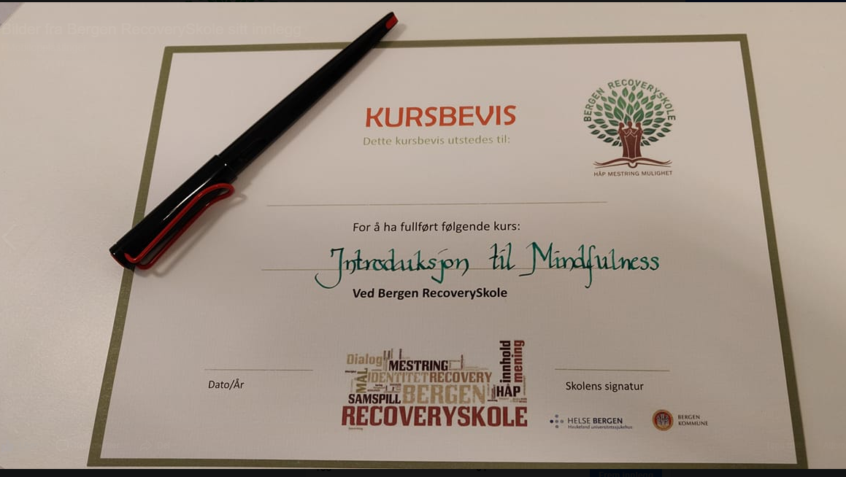
Susanne Albertine Davidsen
Anne Turid Nygaard

