Slide 1
Peer Workers in Holland
How do we get trained?
Where can you find us?

Slide 2
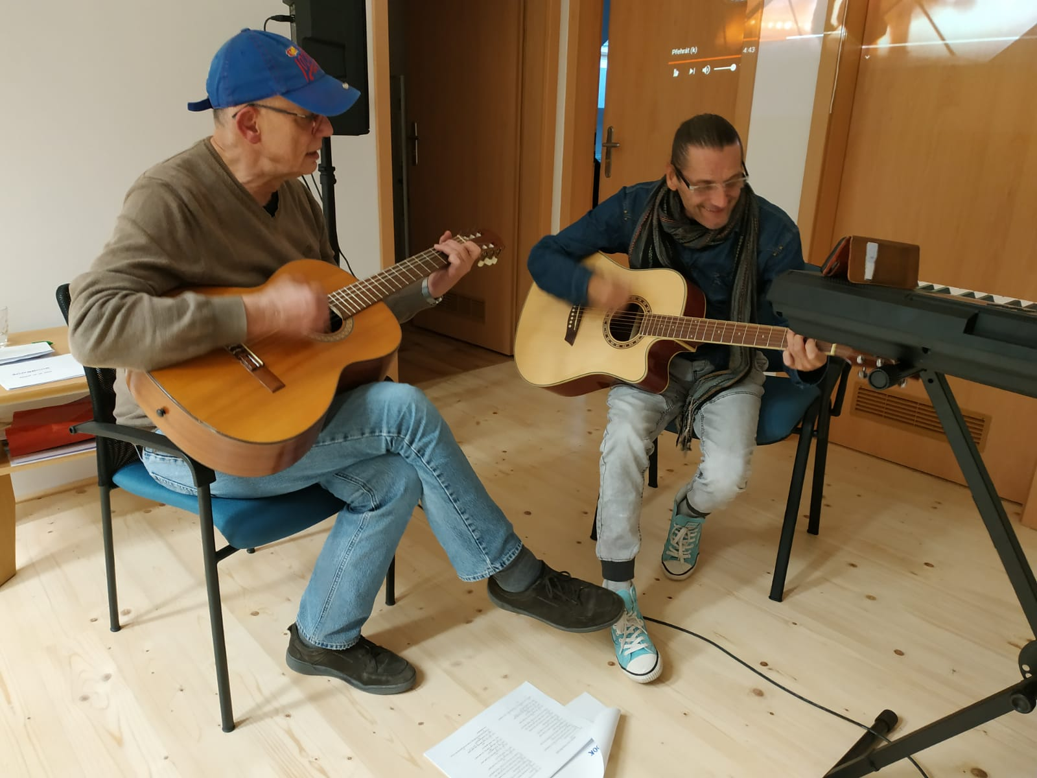
And: who are we?
Trainers
Peer workers
A Co founder and A Peer Worker at Nei Skoen Helmond (www.neiskoen.nl)
Recovery College Eindhoven (www.rc-e.nl )
(and one of us is a brilliant guitar player)

Slide 3
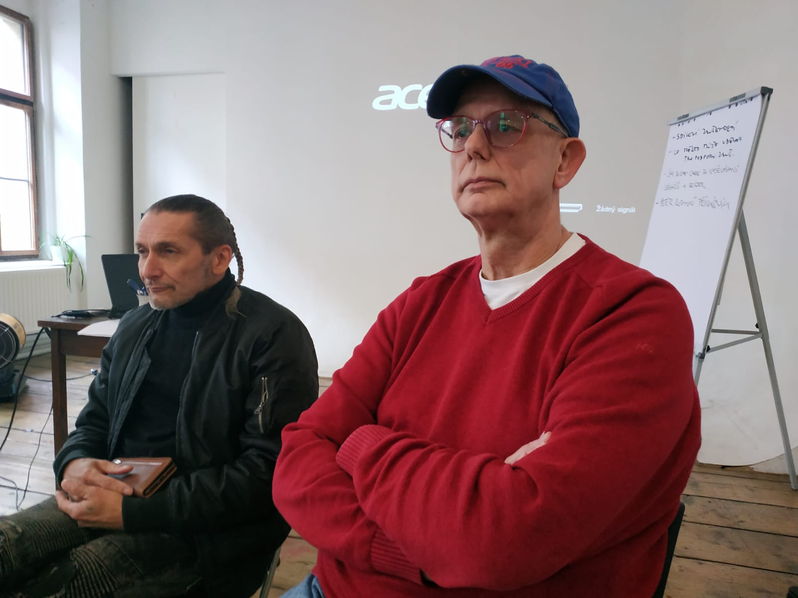
What will we do?
We will give an overview: how are peers trained / educated in Holland
We will give an overview of where peers in Holland can be found
We will share our own personal experience

Slide 4
Different ways of learning: 1: Self Research
Experience
Knowledge by experience
No Beginning <----→ No end
Continuous Interaction
Peer knowledge

Slide 5
Different ways of learning: 1: Self Research
Self research: what have I learned by three evaluations:
The ‘I test’: write your story and read it several times. Improve it.
The ‘you test’: share your story and improve it. Recognitions and Acknowledgement
The ‘We test’: we create our story as family, as team, as group. Typical form: the holiday story of a family
Recognitions and Acknowledgement
A port folio as a visible result of self research
In most training programs for peer workers
this is an important part

Slide 6
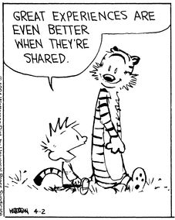
Different ways of learning: 2: Sharing Experiences
Sharing stories of experience
Contributes to the development of experiential knowledge
Helps organizing and analysing experiences
Finding Cohesion and finding those elements that matter
Recognizing
Acknowledging

Slide 7
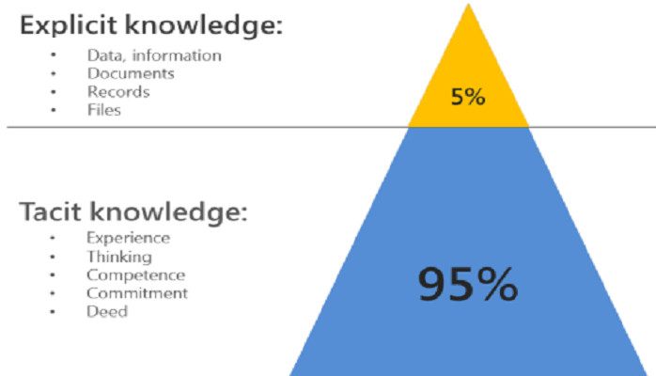
2: Sharing Experiences why do peers understand each other so easily?
The experience expert knows better than anyone how important it is to share experiences.
We speak here of Tacit knowledge: https://en.wikipedia.org/wiki/Tacit_knowledge
We understand the unspoken words

Slide 8
Several informal ways:
Many informal ways in which people can develop experiential expertise, such as :
by following courses and workshops
participating in self-help groups
working as a volunteer in assistance.
InterVision and Supervision are often used to deepen and strengthen experiential expertise.

Slide 9
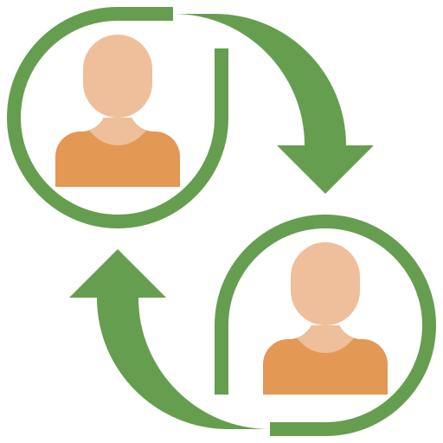
Examples of peer by peer trainings
Recovery it is up to you
12 meetings with different themes in which participants open up and share
Evidence based
Working with my own experience
For people who want to orient themselves on the use of their own experiences with mental health care, addiction care and social care.
No requirements regarding education and work experience. With a minimum attendance of 10 of the 12 lessons

Slide 10
Different kinds of training to become a peer trainer
Training and education offered by various organizations and institutions.
For example, there are training courses to become an expert by experience in mental health care, addiction care and care for the homeless. These courses can vary from a few days to a few years, depending on the institution and the level of the course.

Slide 11
Examples OF larger trainings:
Associate degree :
a 2-year training - 1 day a week. Needed: client experience
Result: Professional Peer worker
Level: bachelor
How:
You learn how to use your own disruptive (client) experiences to support others in finding space for their personal (recovery) process, rediscovering social roles and emancipation.

Slide 12
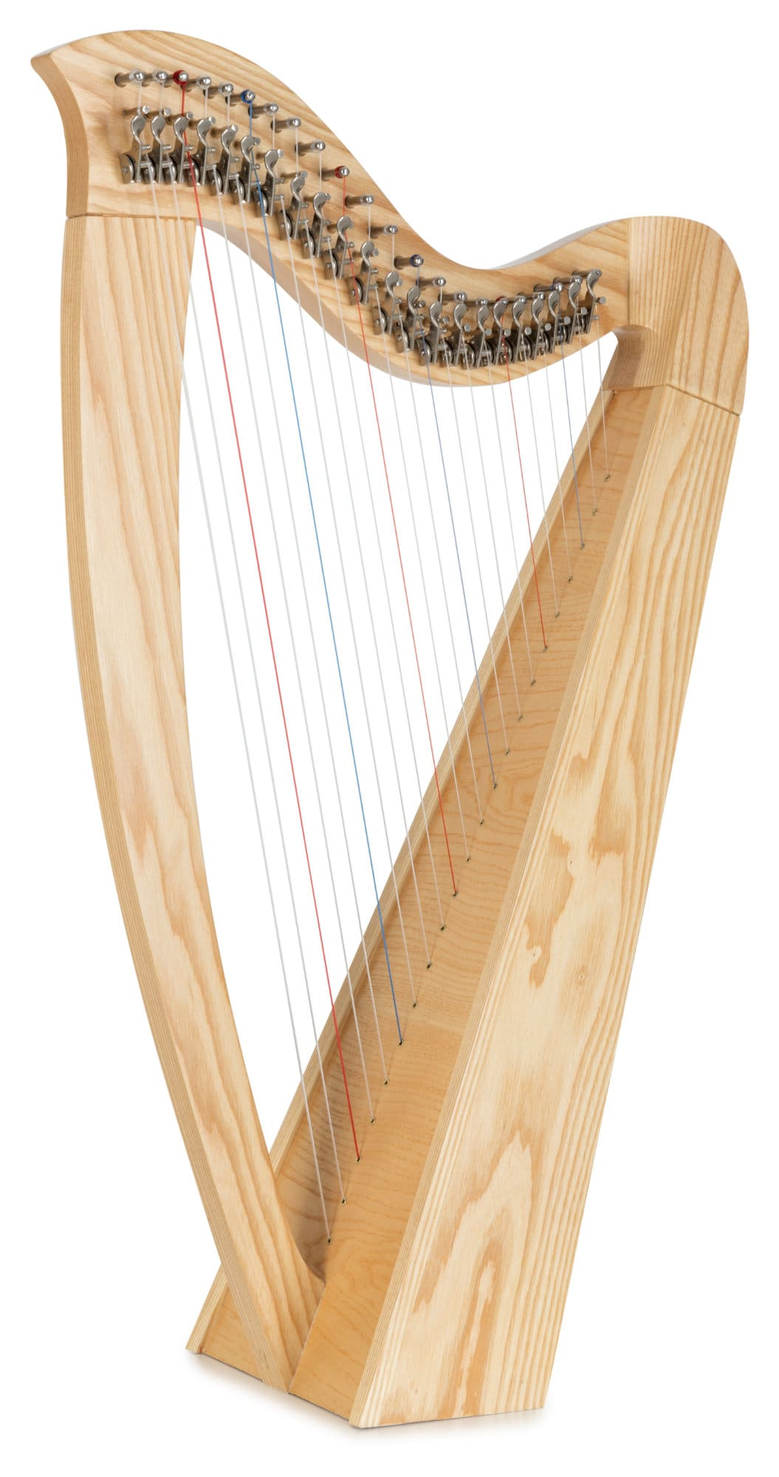
Examples OF larger trainings:
Howie the Harp :
a 1-year training – 4 days a week and half a day online
Result: Professional Peer worker
How:
your recovery process and that of your fellow students is part of the overall learning process. You learn to look at personal experiences from a distance and learn your own life lessons from them
You have your own coach
Luciano can share his experience here

Slide 13
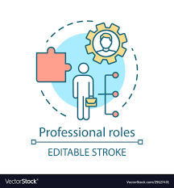
Professional roles peer worker:
Supporting individual recovery processes
Facilitator: recovery groups, selfhelp groups, communities of practise
Activist: ‘Quarter Maker-’, sharing knowledge, fighting stigma
Trainer, coach, supervisor
Researcher, publisher
Supervisor, coordinator of recovery in initiatives
Policy Maker

Slide 14
Peer work has a broad range of fields:
From ‘helping with home work’
And ‘swimming lessons’
To ‘Certified Peer worker’
And everything in between

Slide 15
Different Recovery Initiatives:
A Recovery College is a place where people recover by learning.
Most common activities: workshops, trainings,
presentations etc
A Living Museum is a place where people recover by making art.
A Recovery Learning Community is a place where people recover by being part of a supportive community. Participants can learn of everything that happens
Participants are students
Participants are artists
Participants are participants
These are usually 100 % Peer Run

Slide 16
What do they have in common?
All these initiatives provide a free space, a sanctuary which is like an oasis in the world of protocols and regulation
They all are driven by peer workers, mostly 100 % peer run
They improve the quality of the neighborhood
We need more of them and in a wide variety

Slide 17
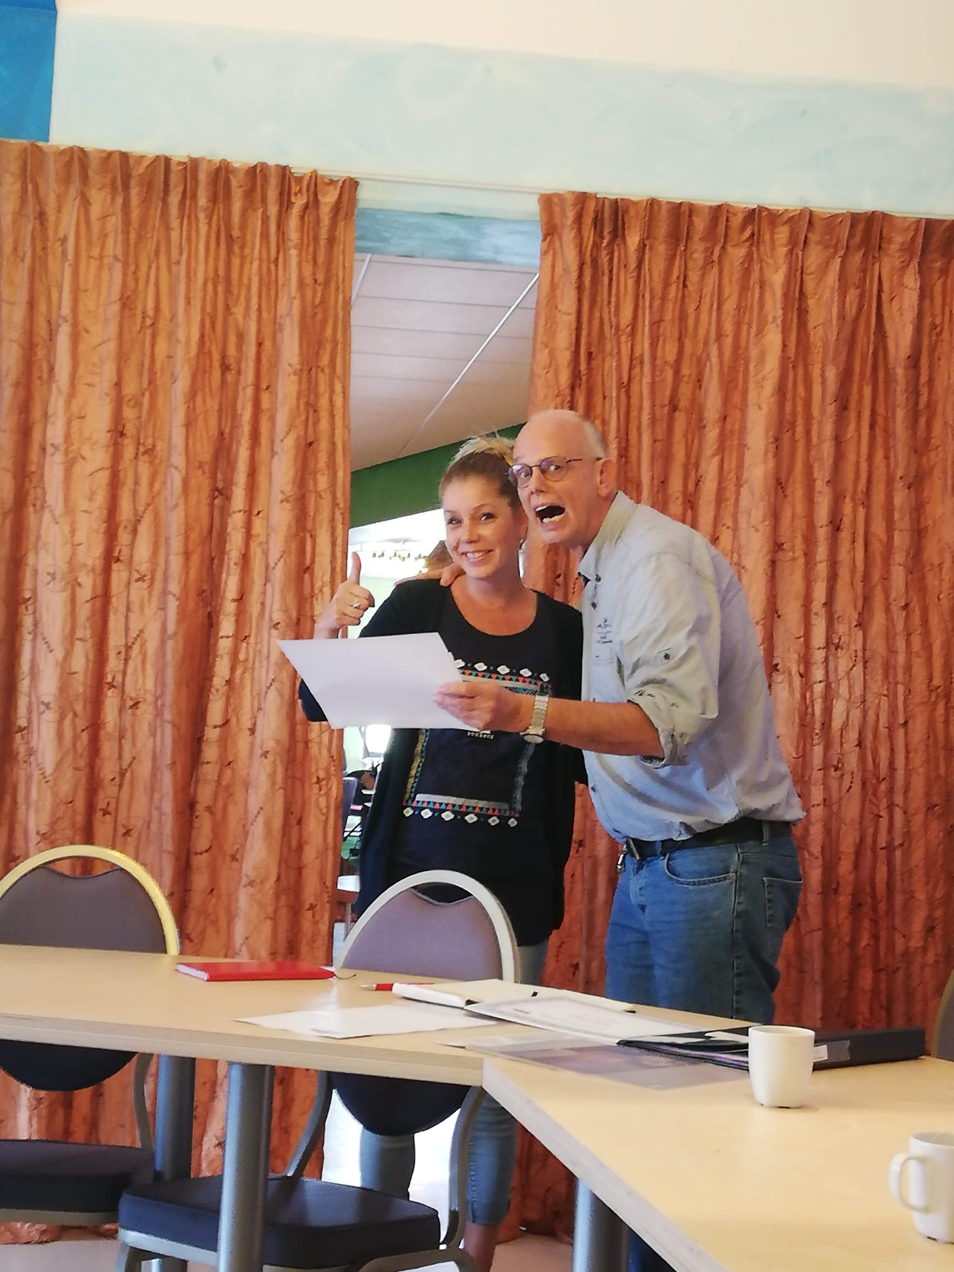
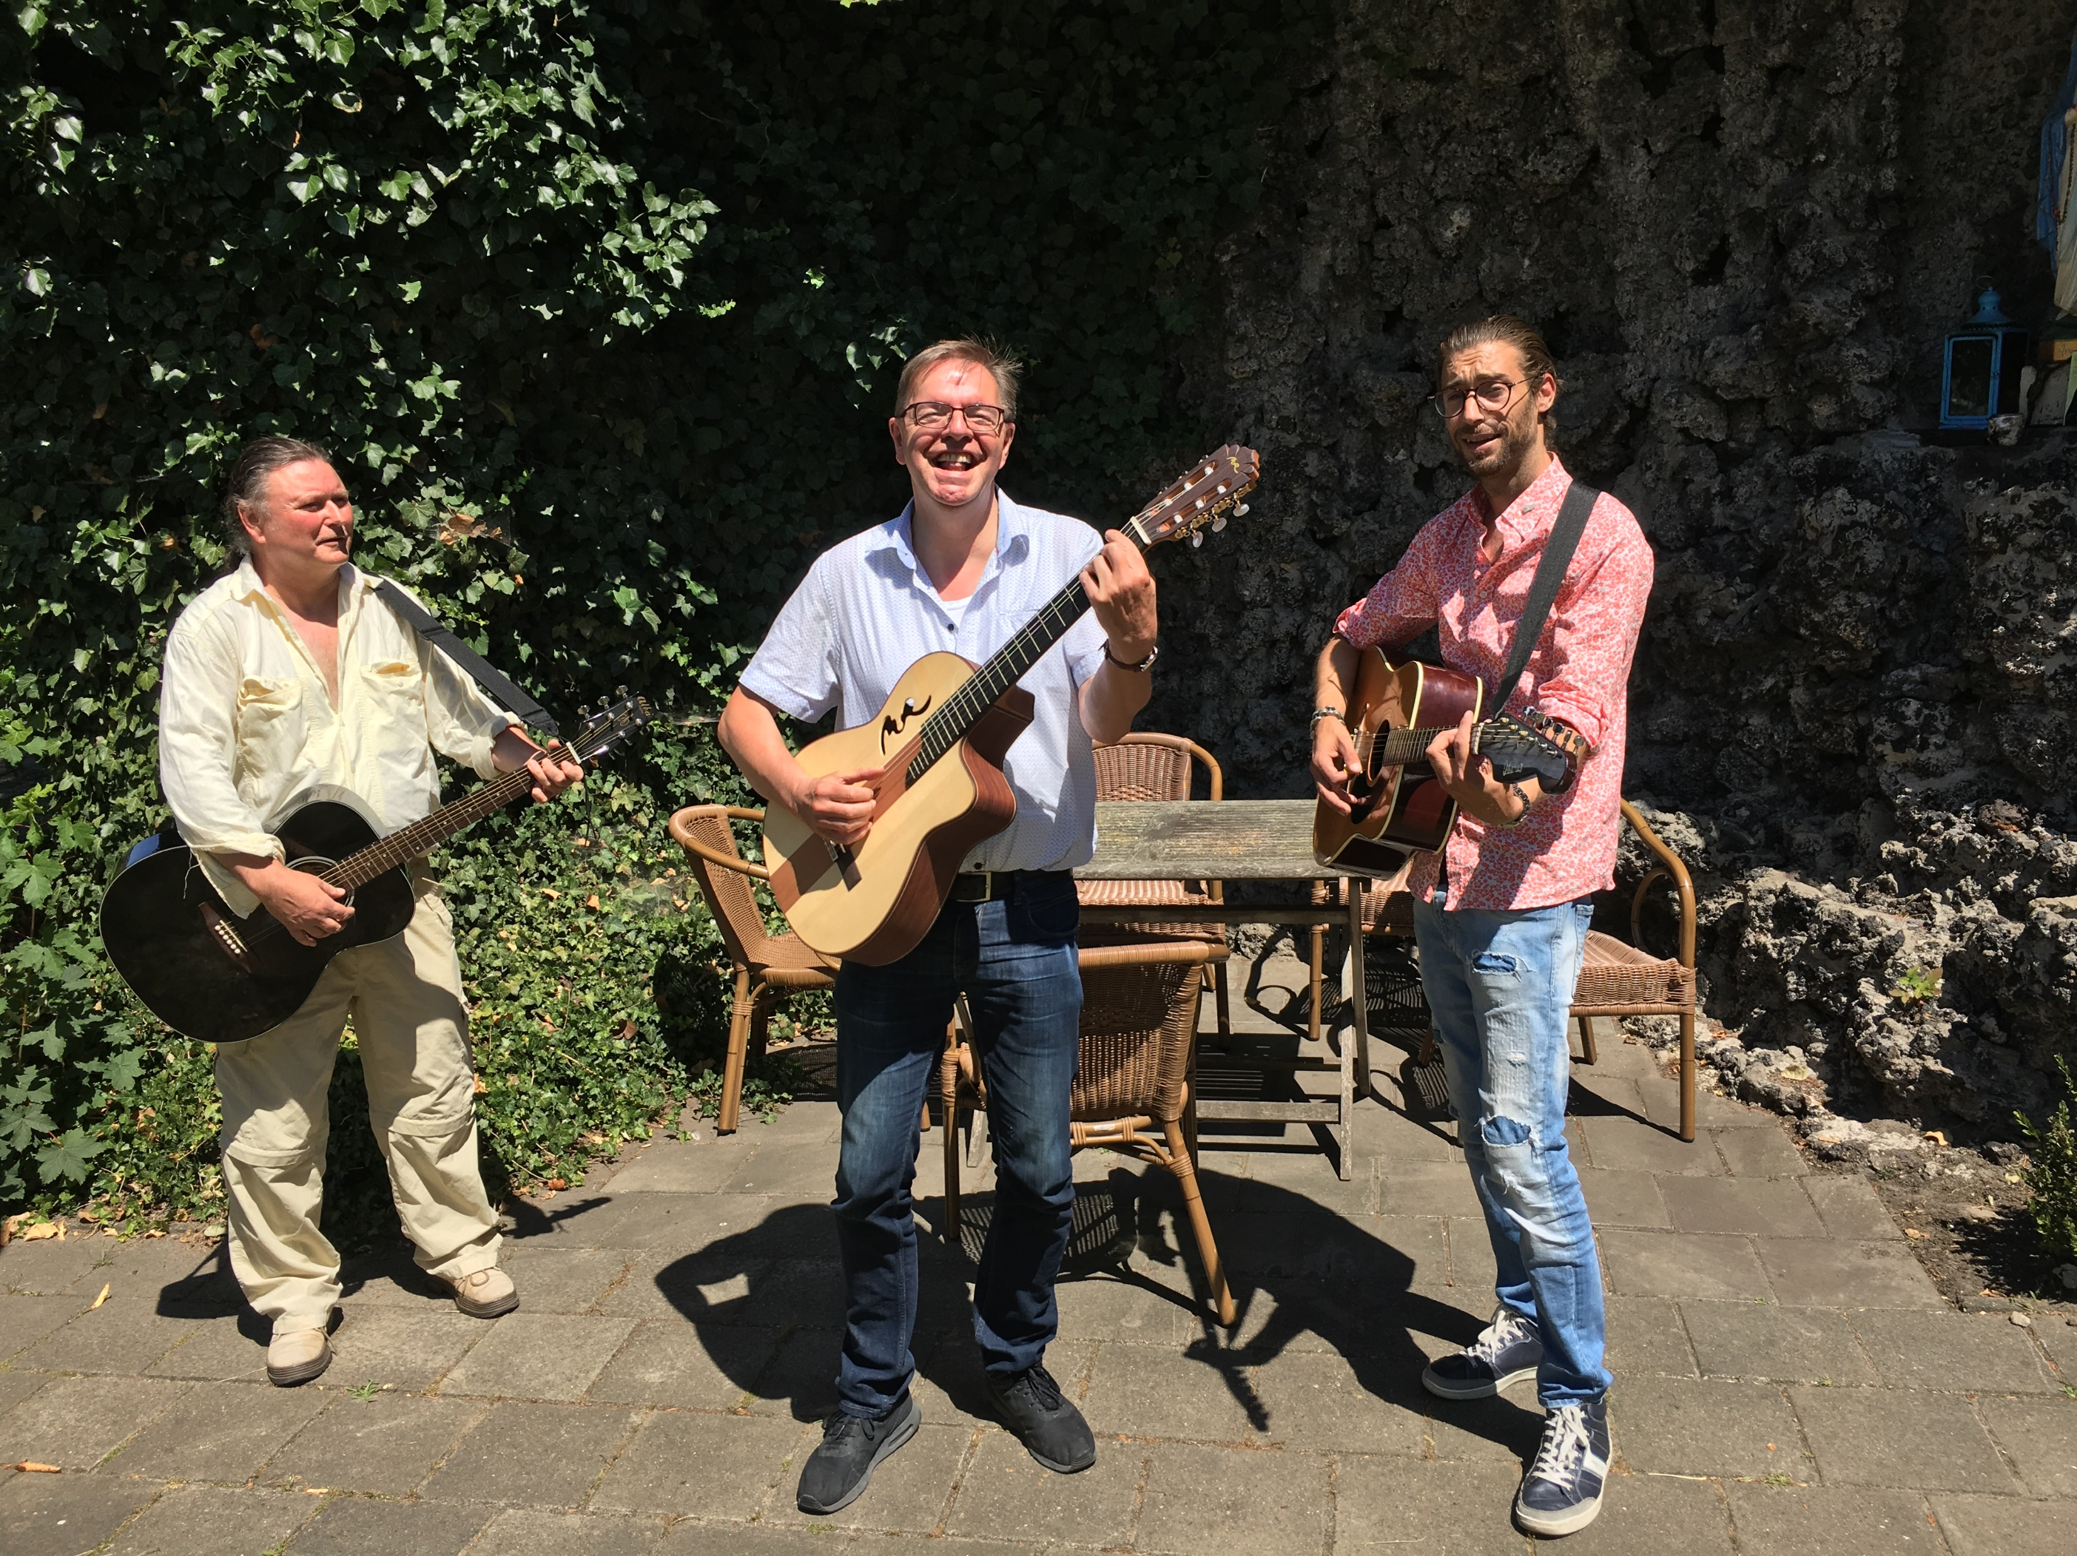
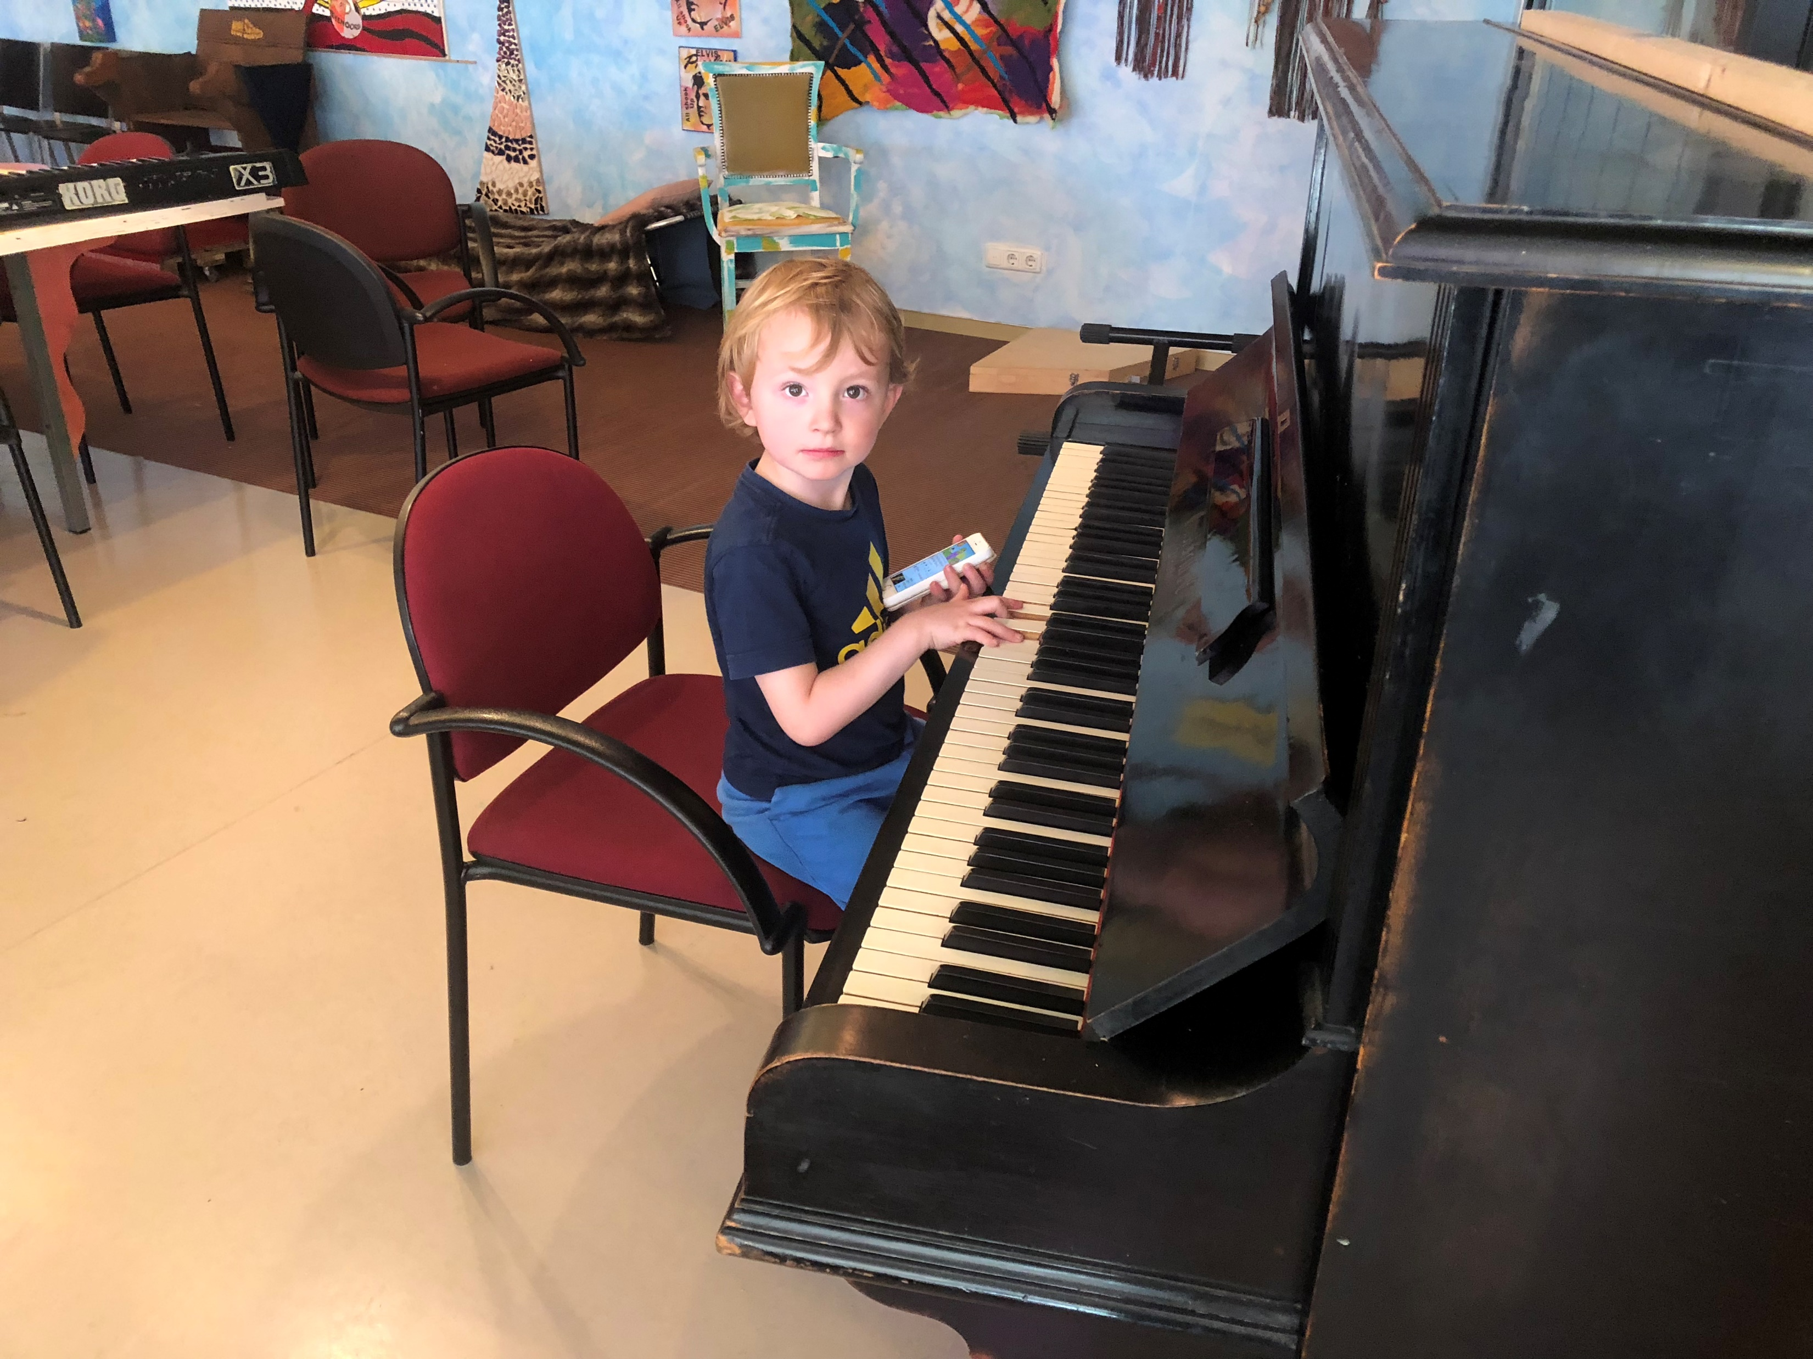
Music makes miracles

Slide 18
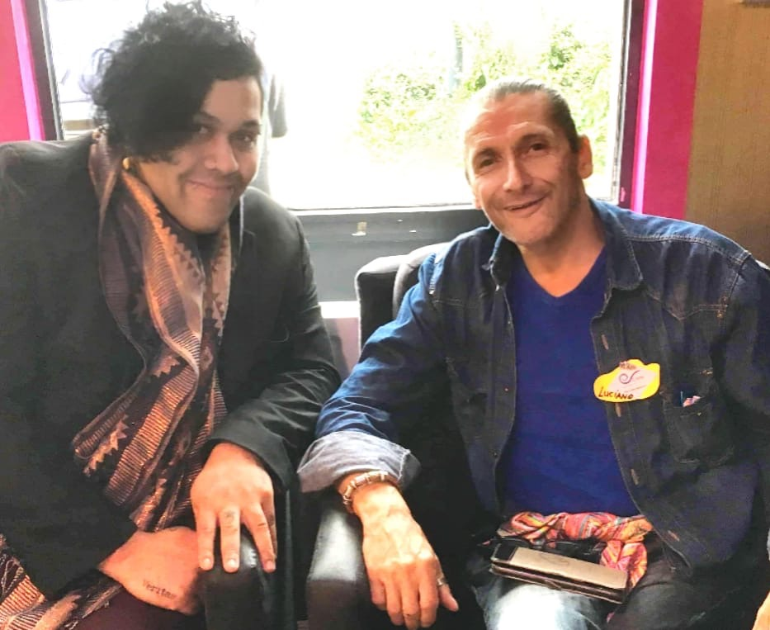
Luciano shares some experiences as Peer Worker in two Recovery initiatives

